Slide 1






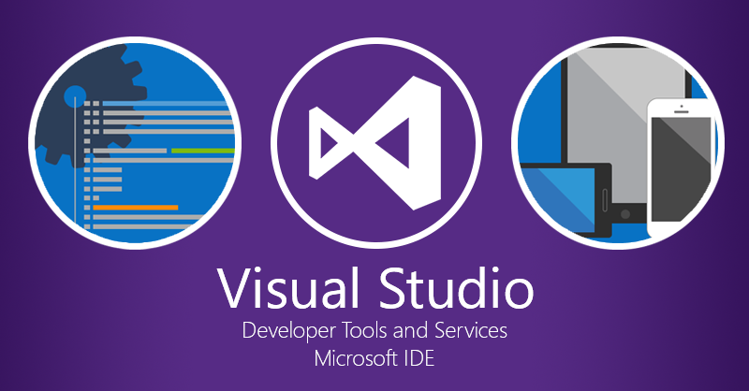

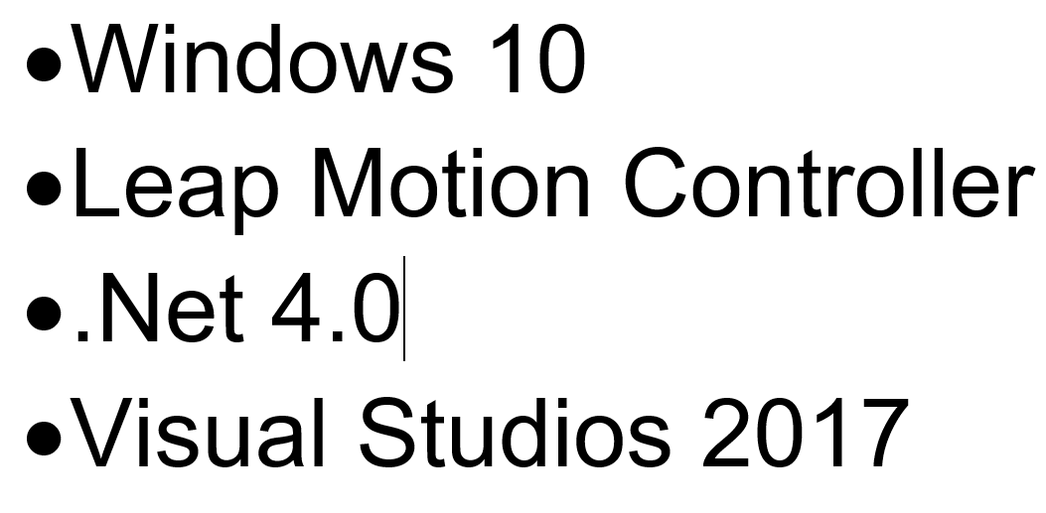
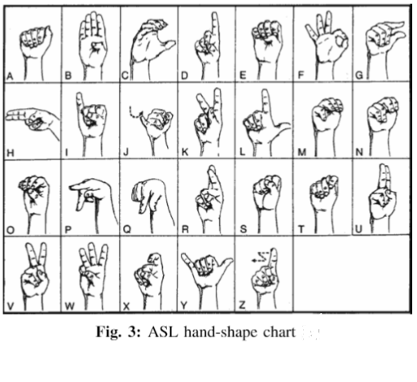
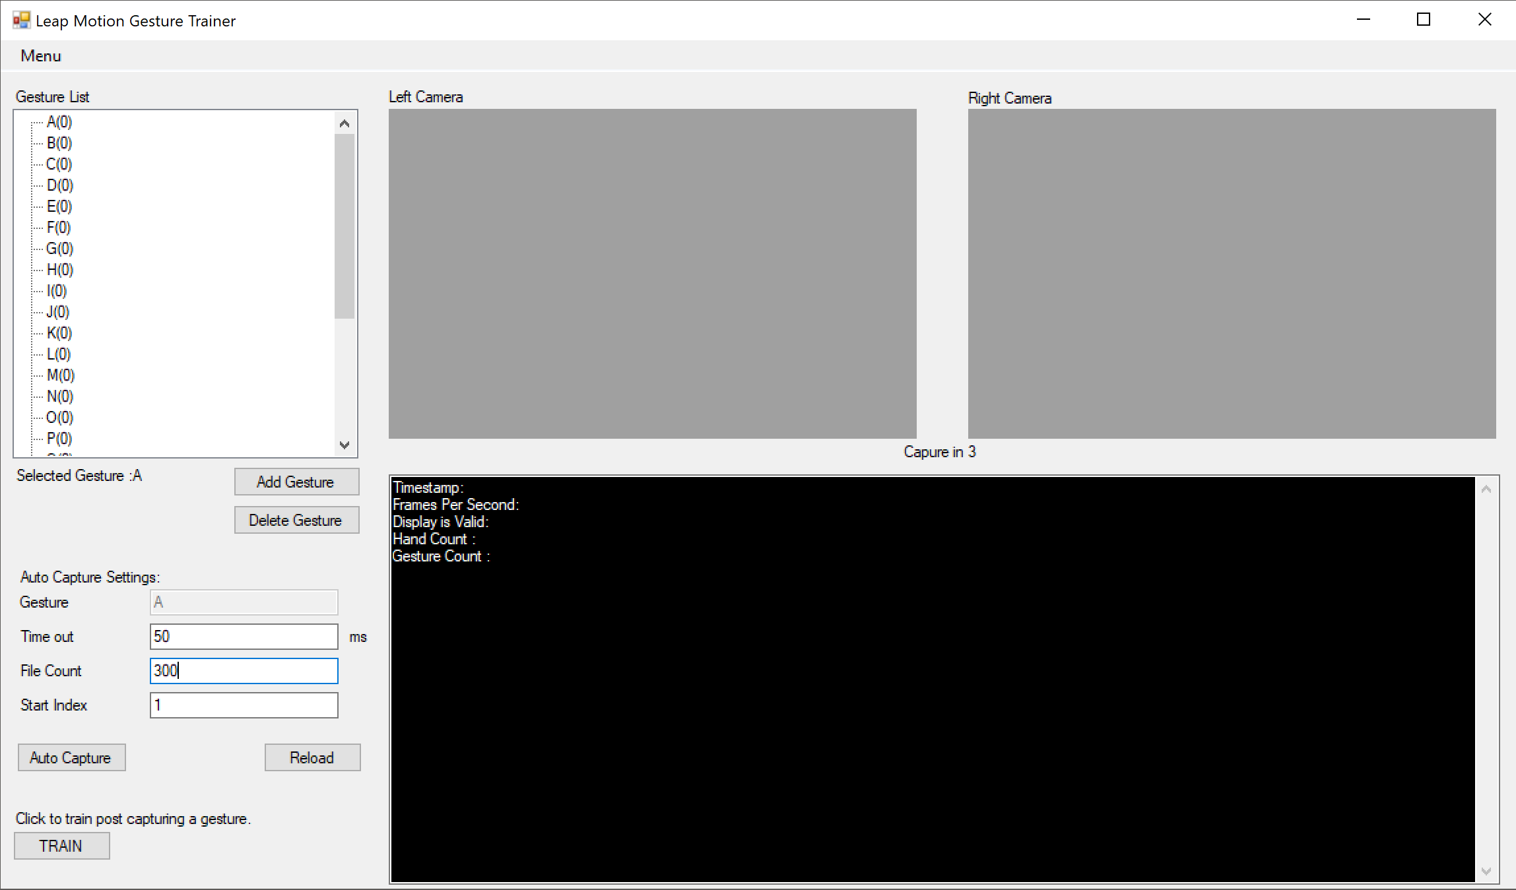
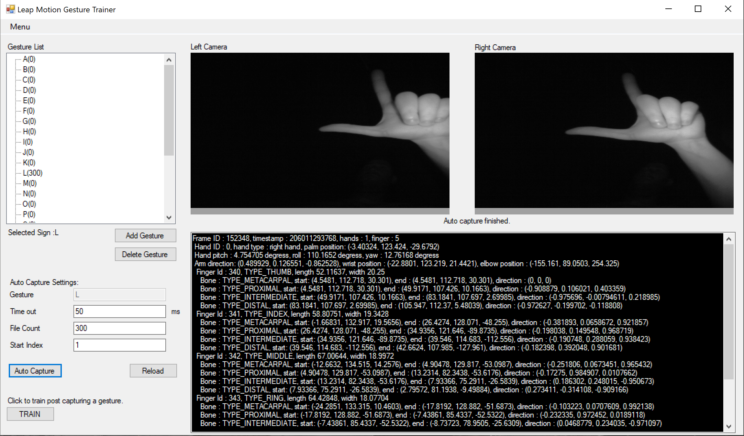
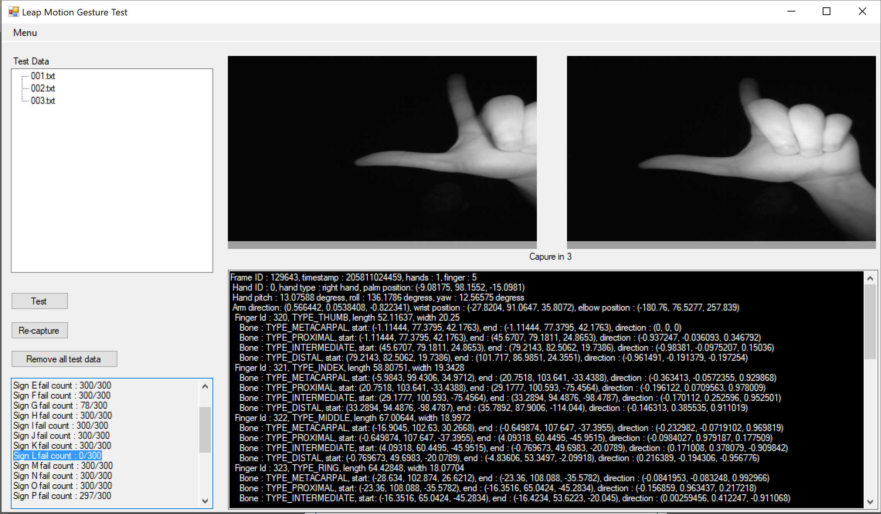
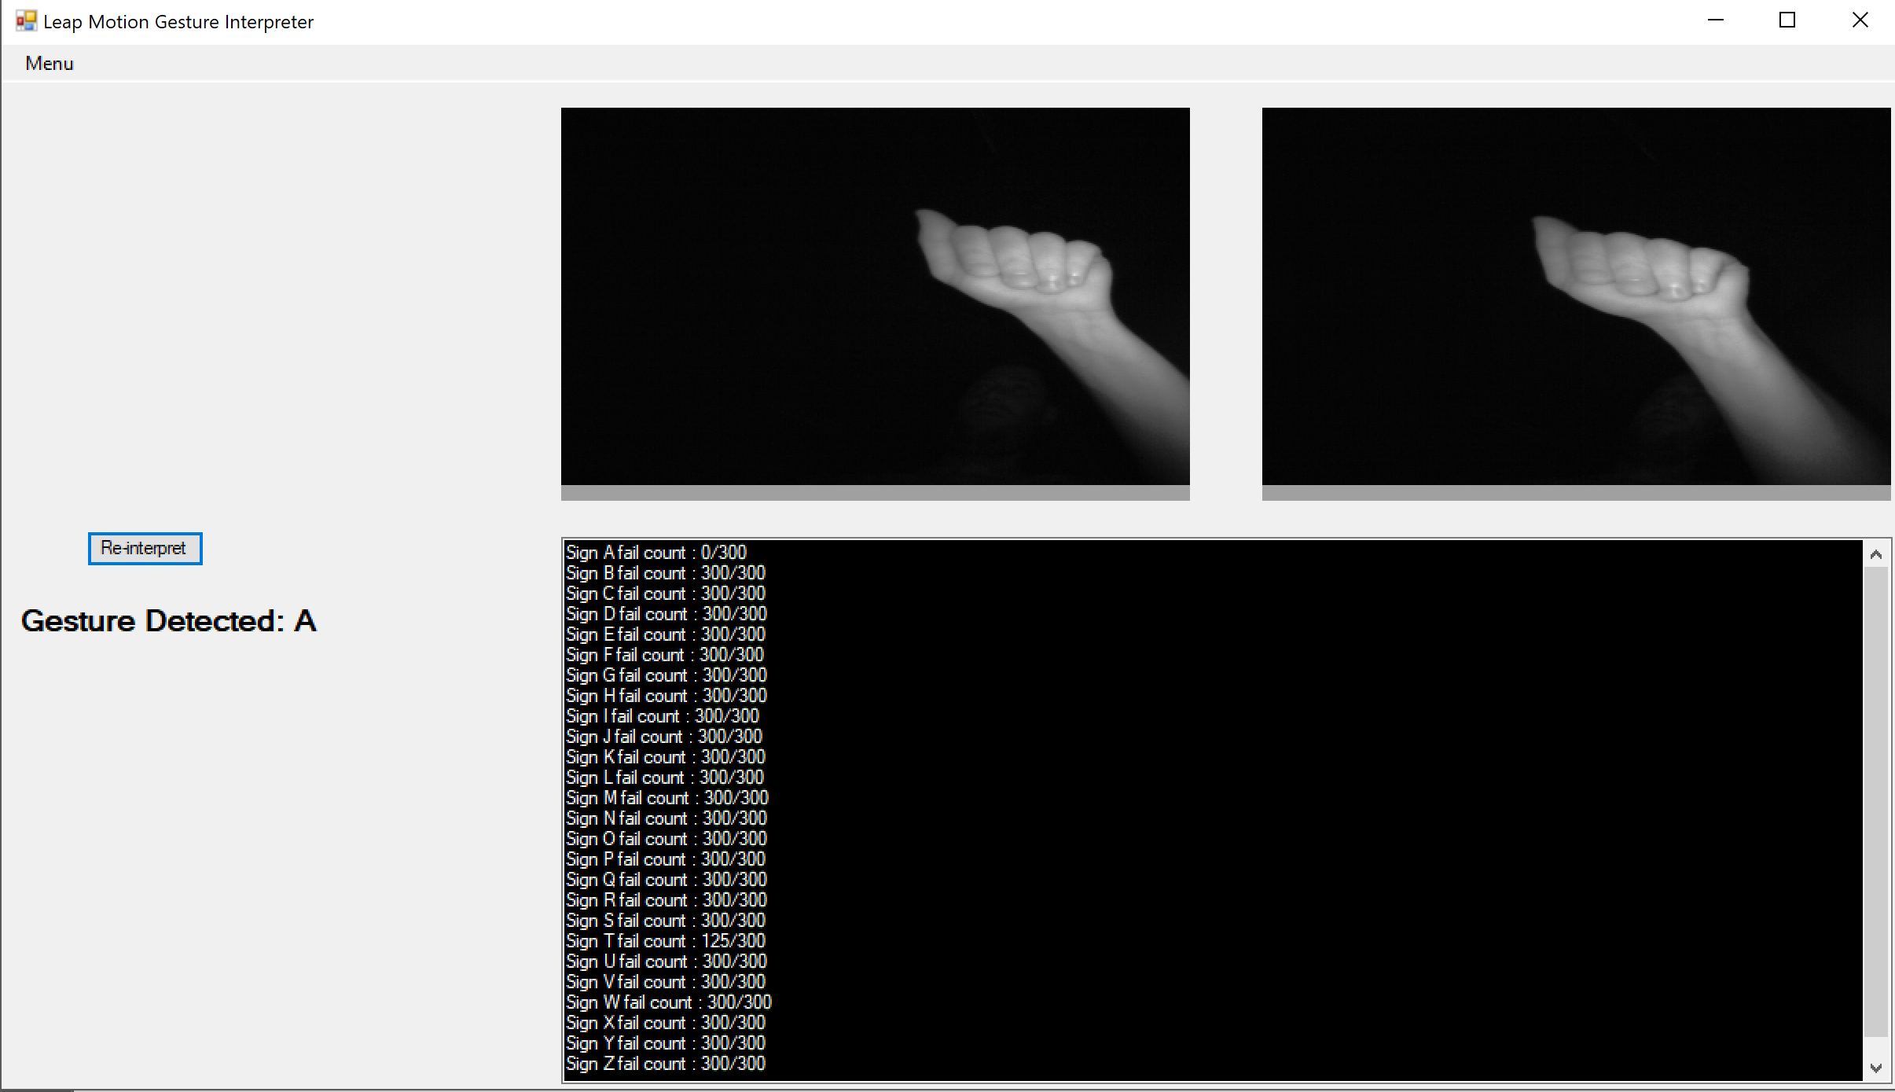
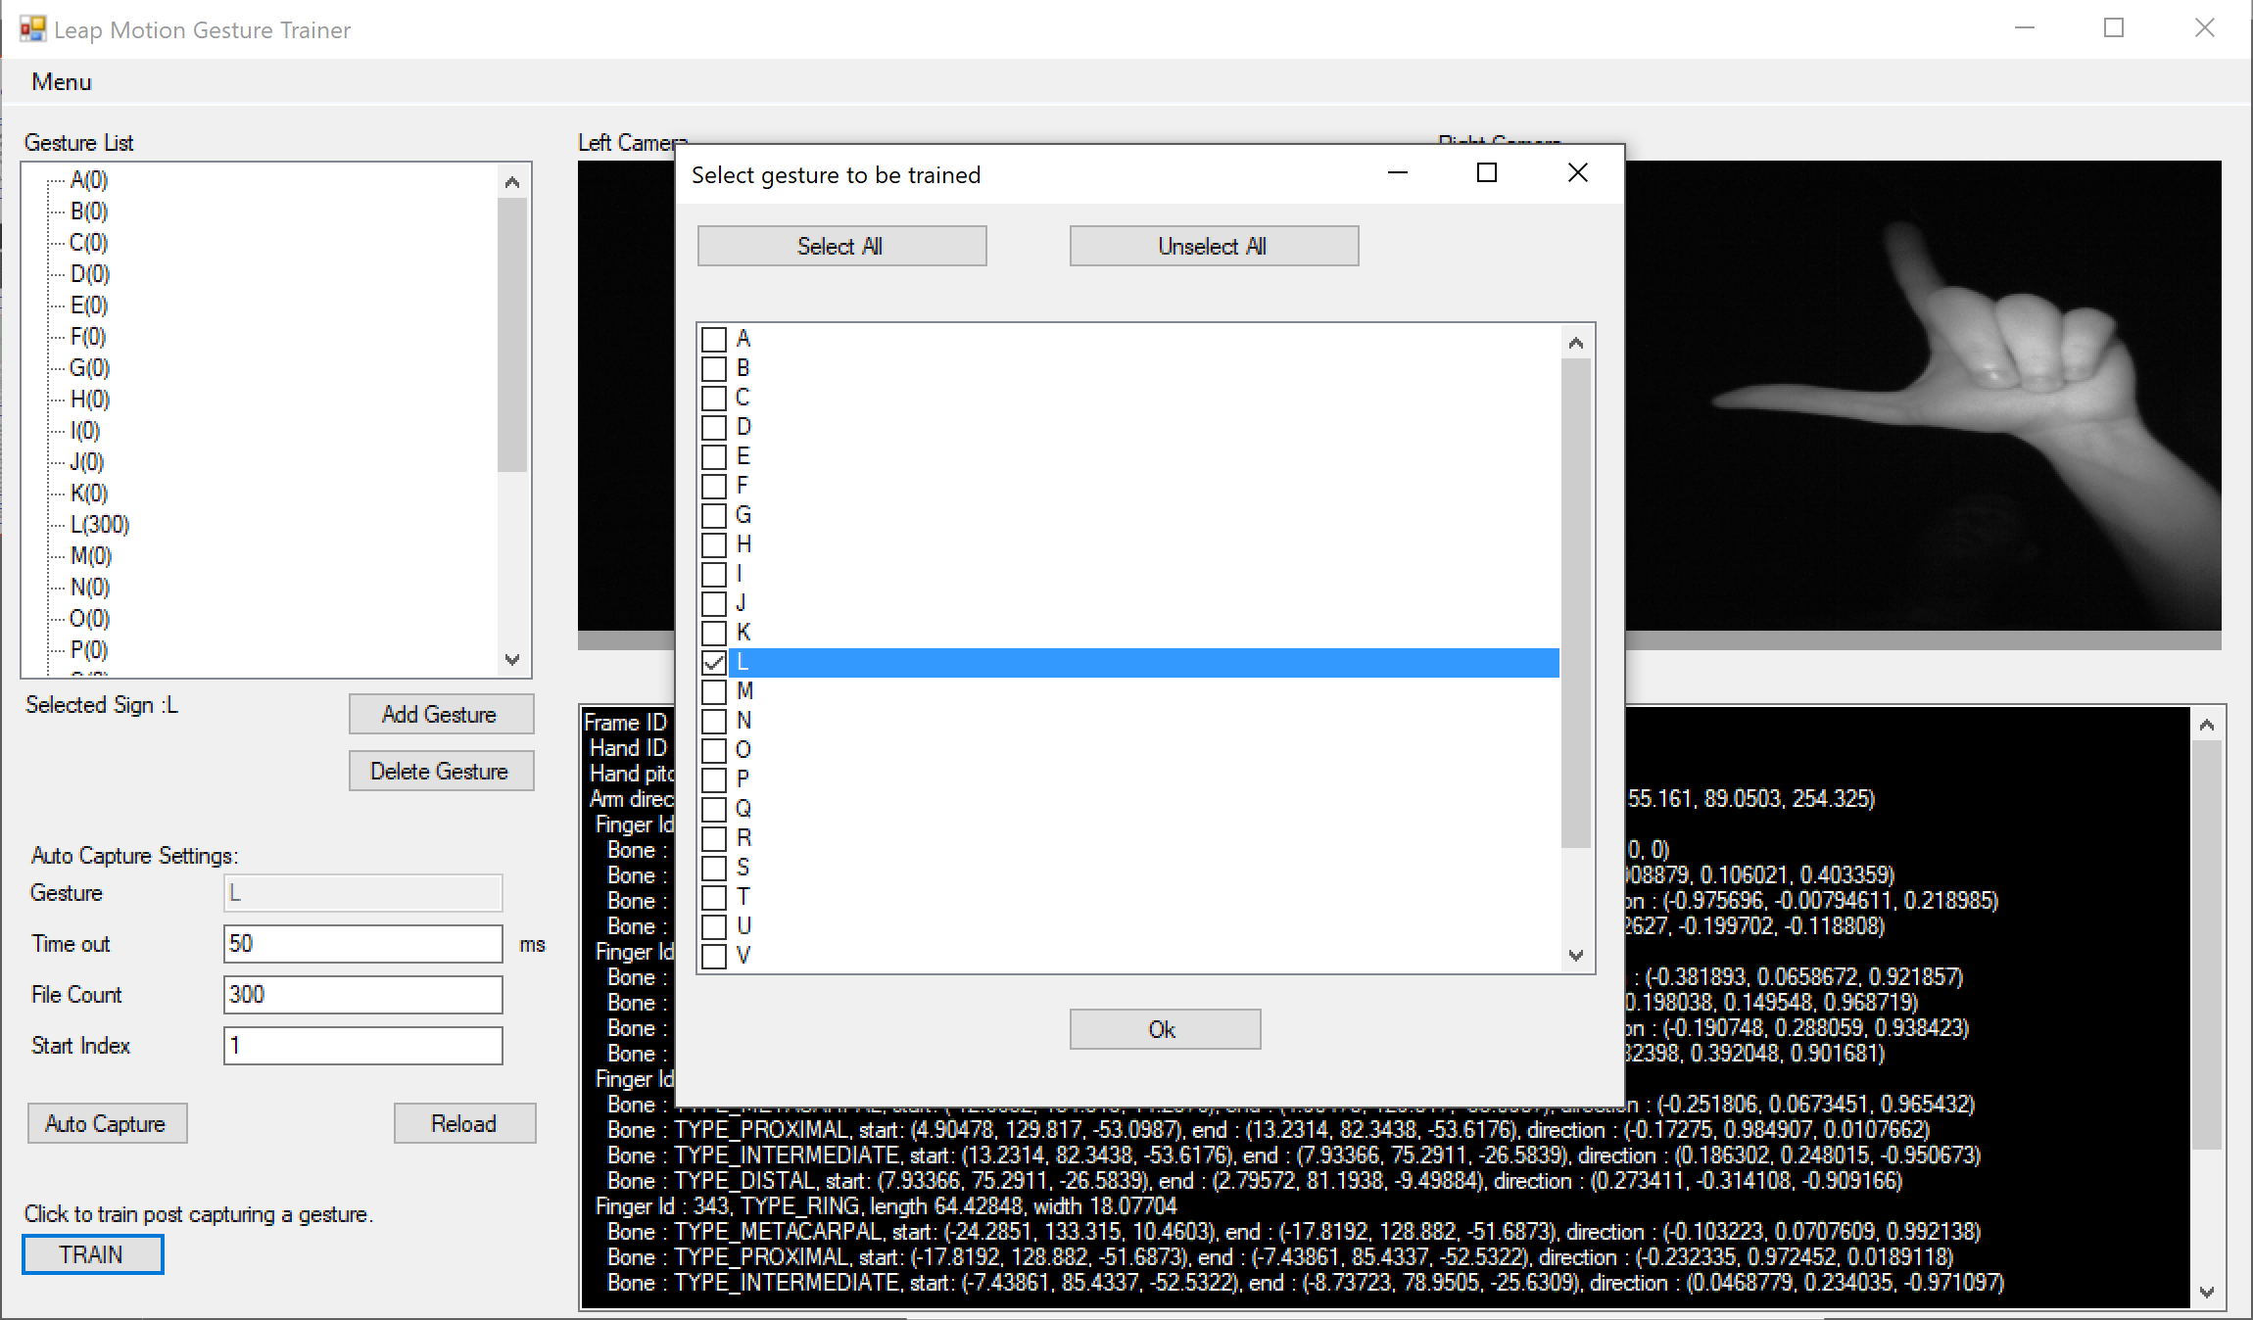
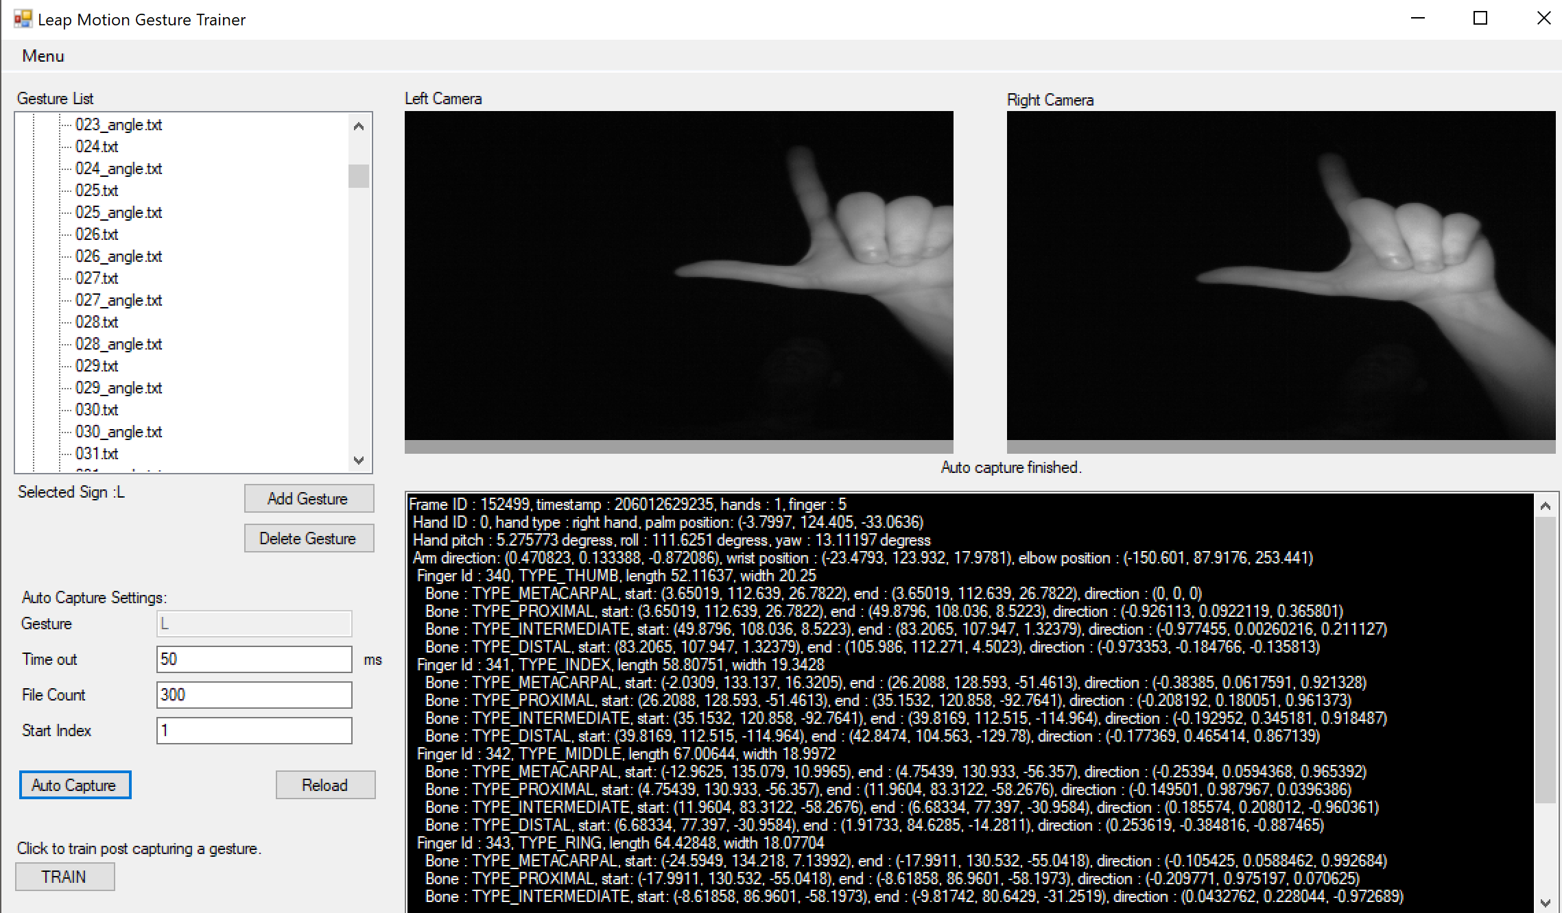
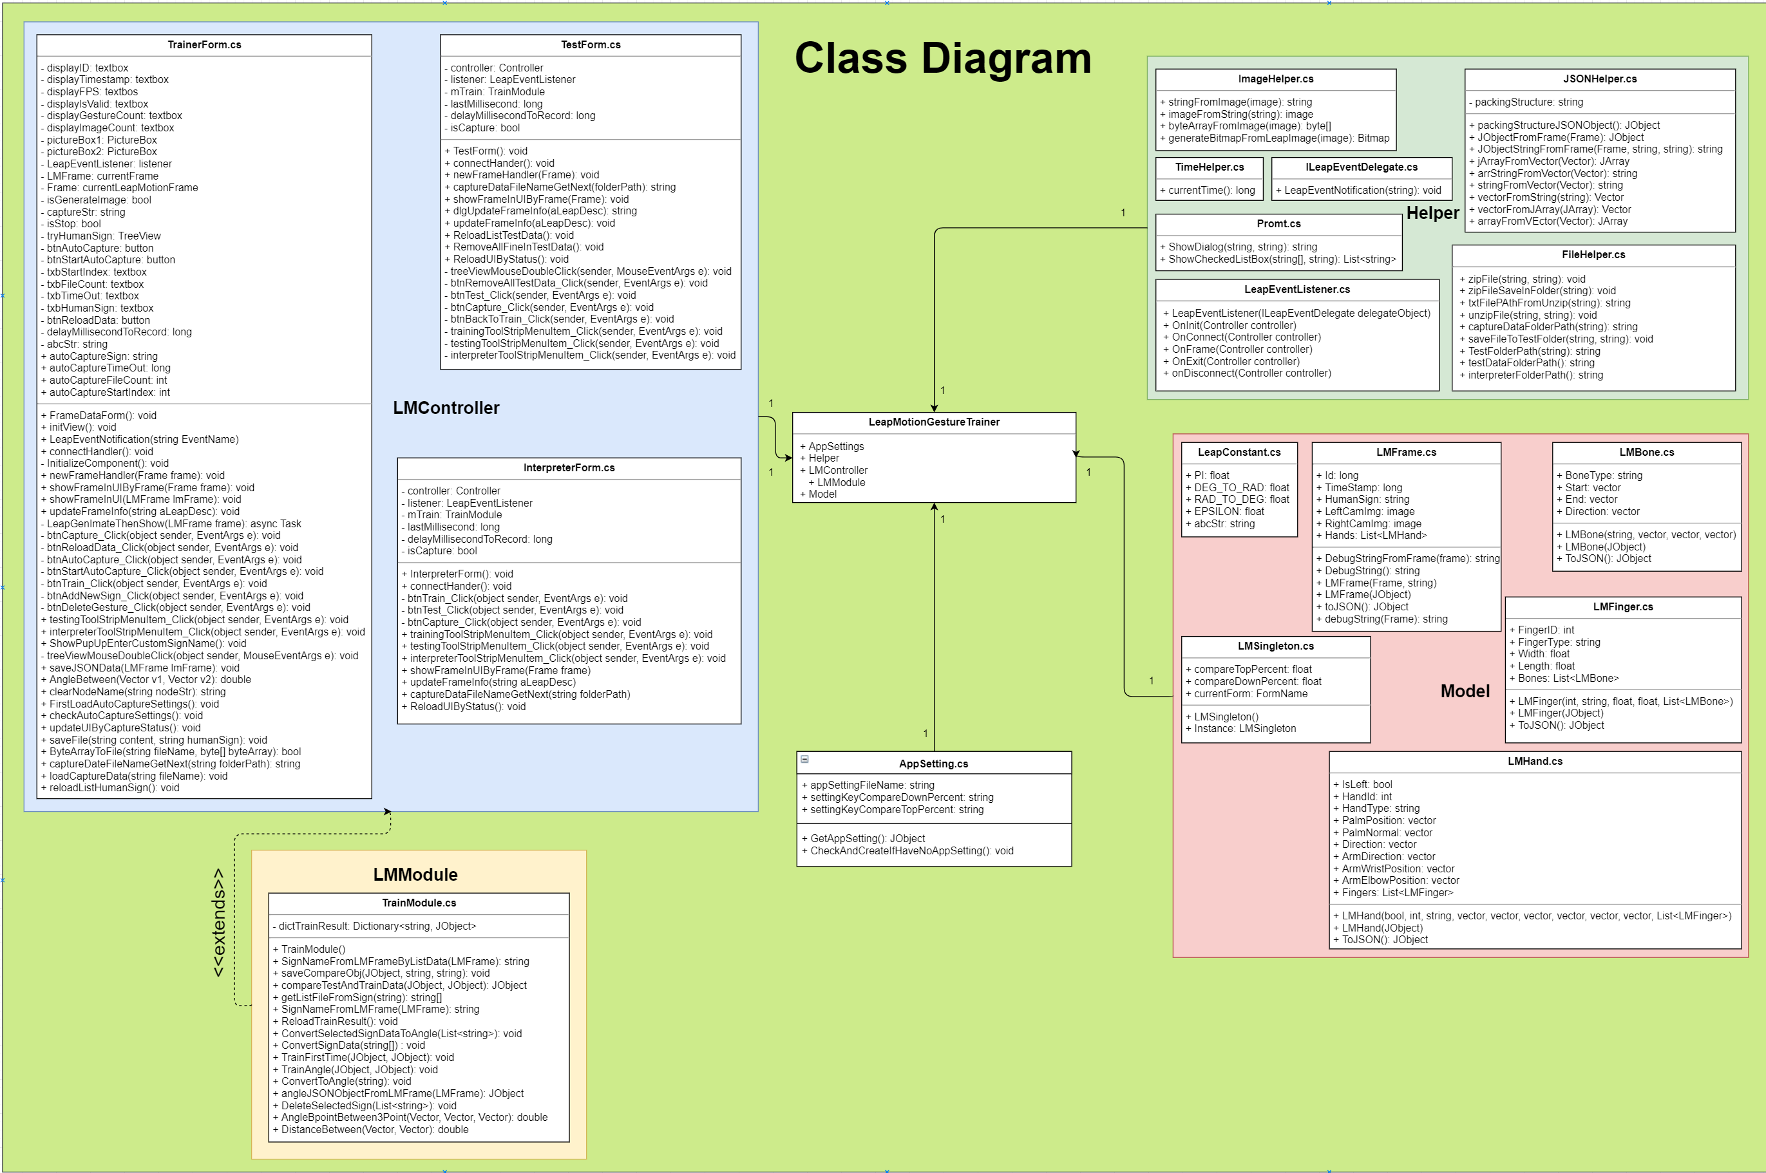

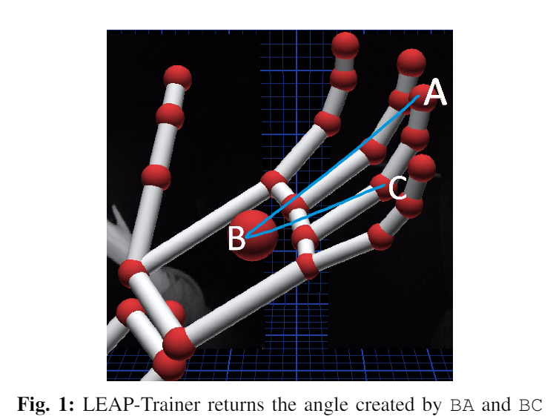
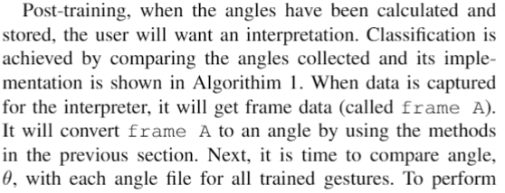
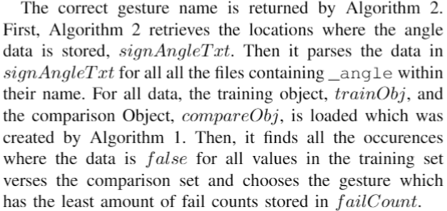
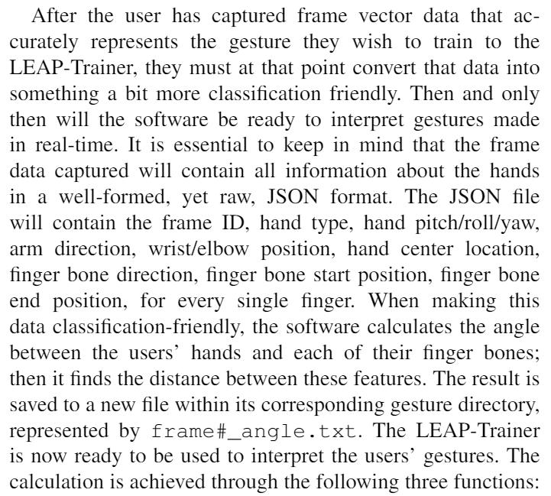
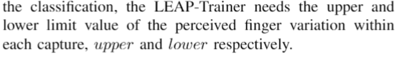

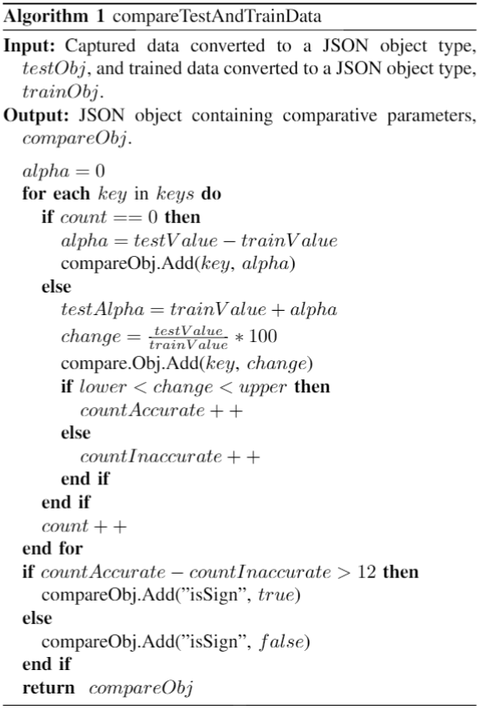
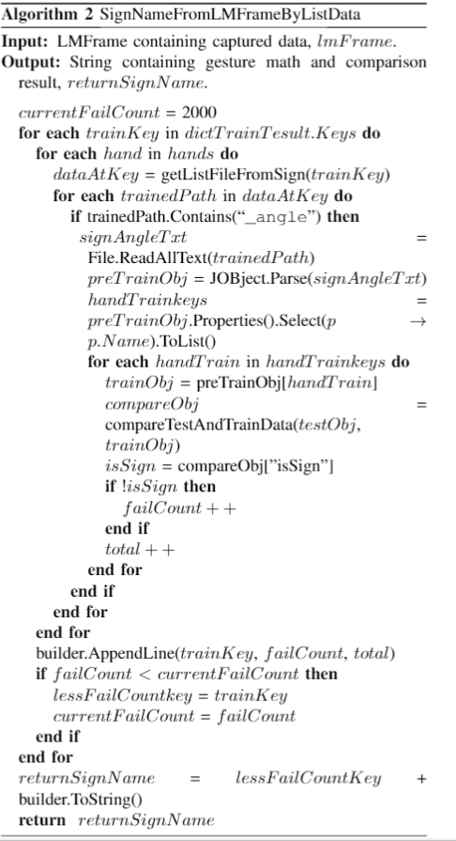
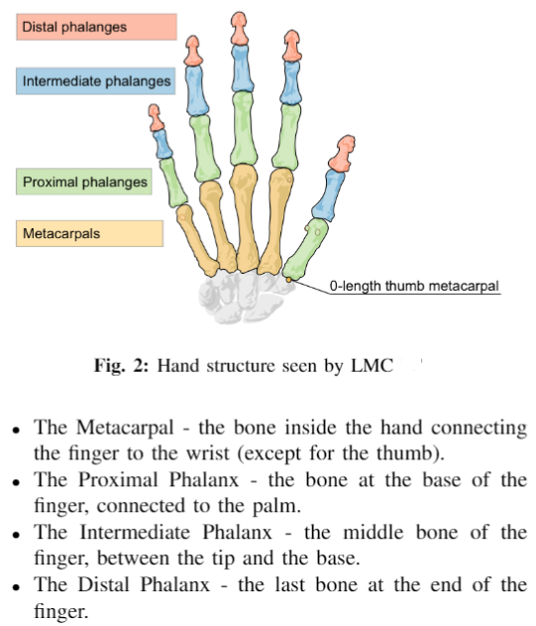
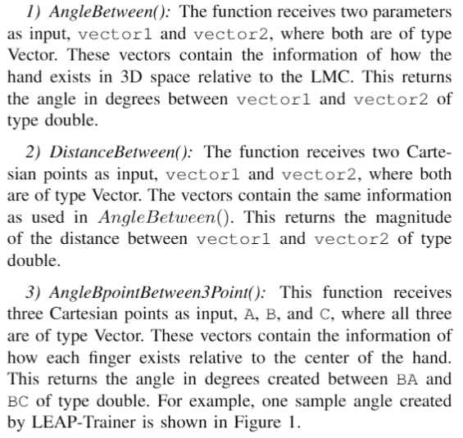
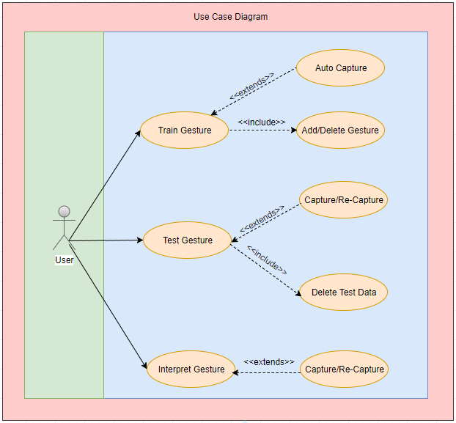
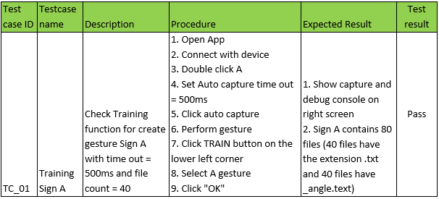
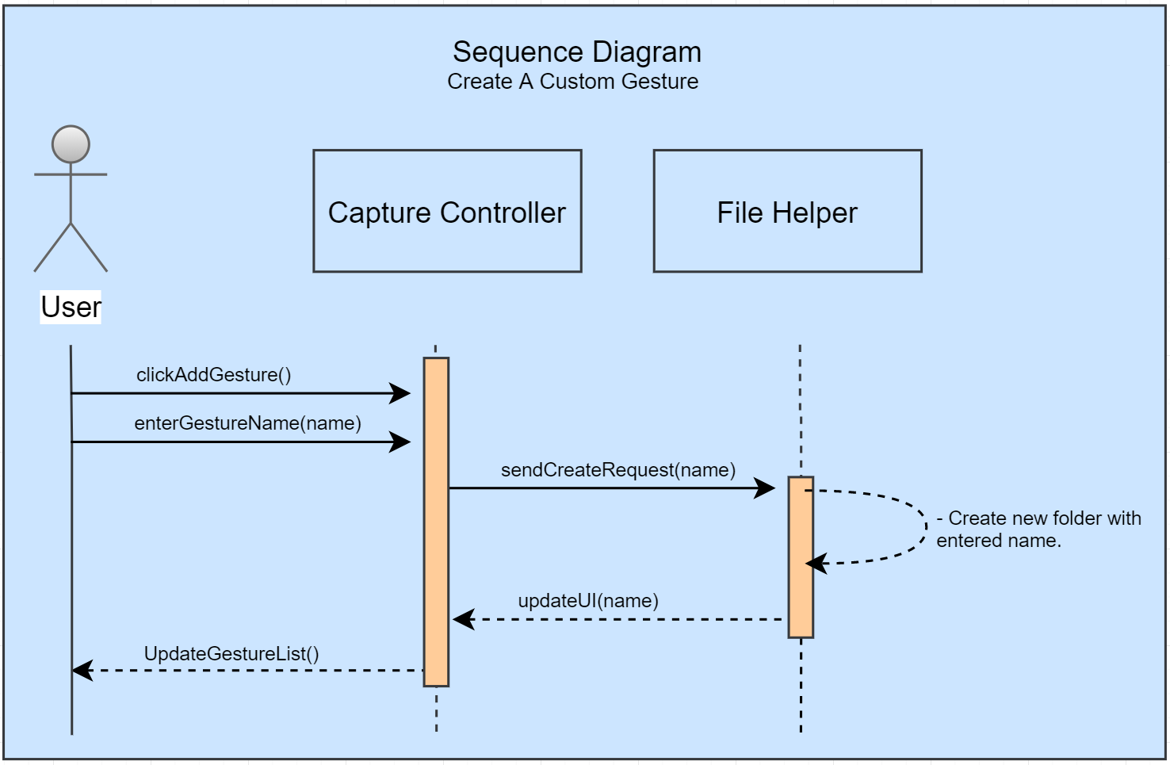
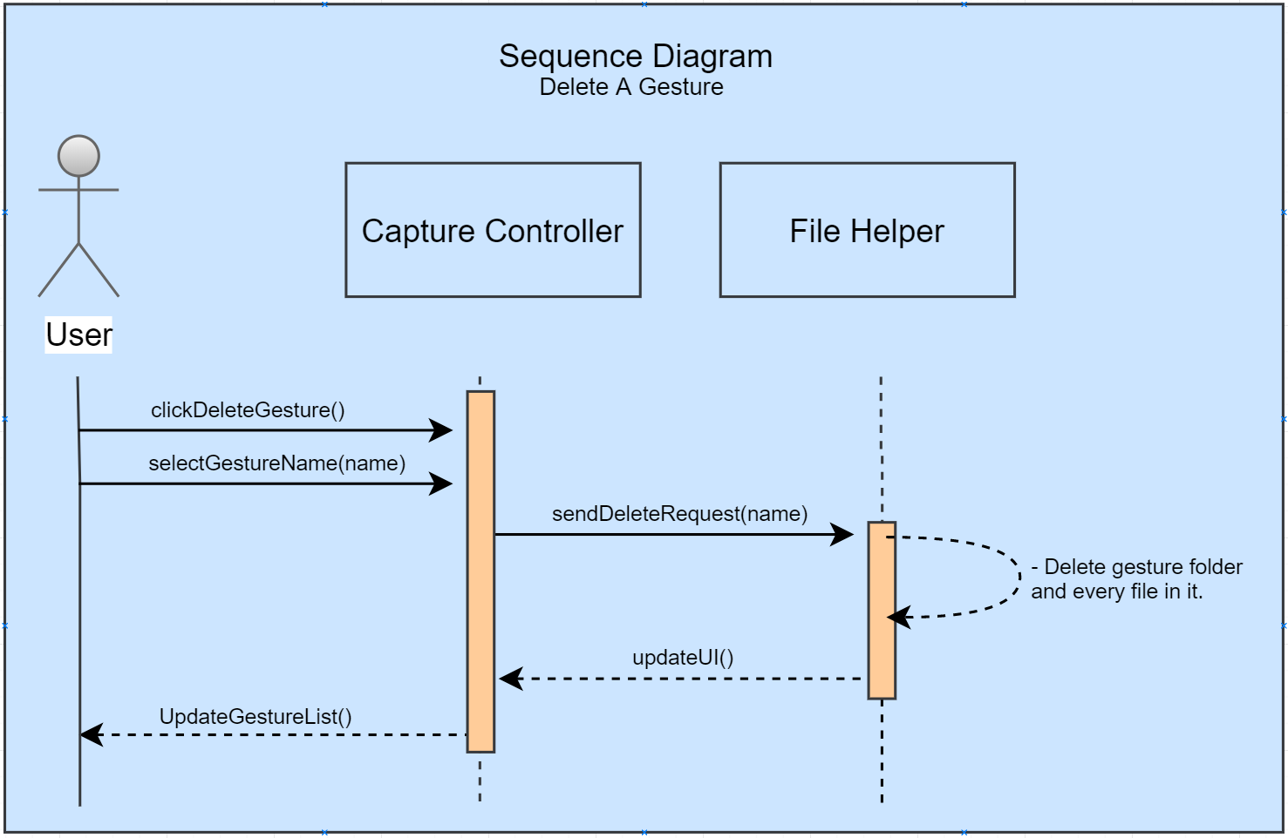
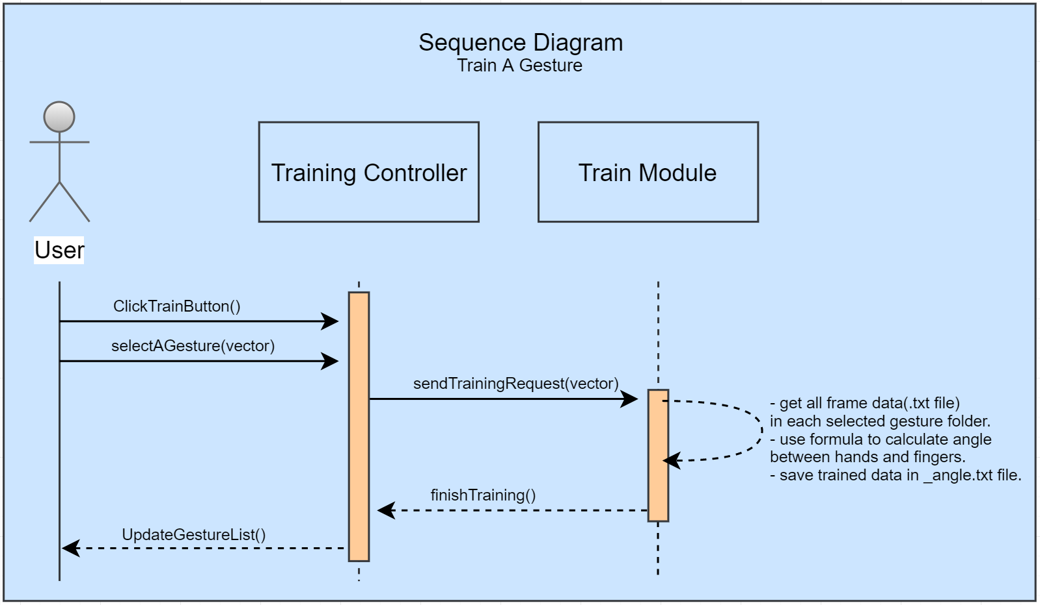
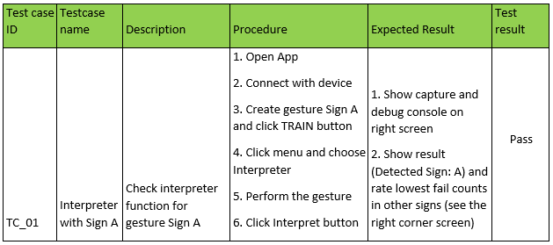
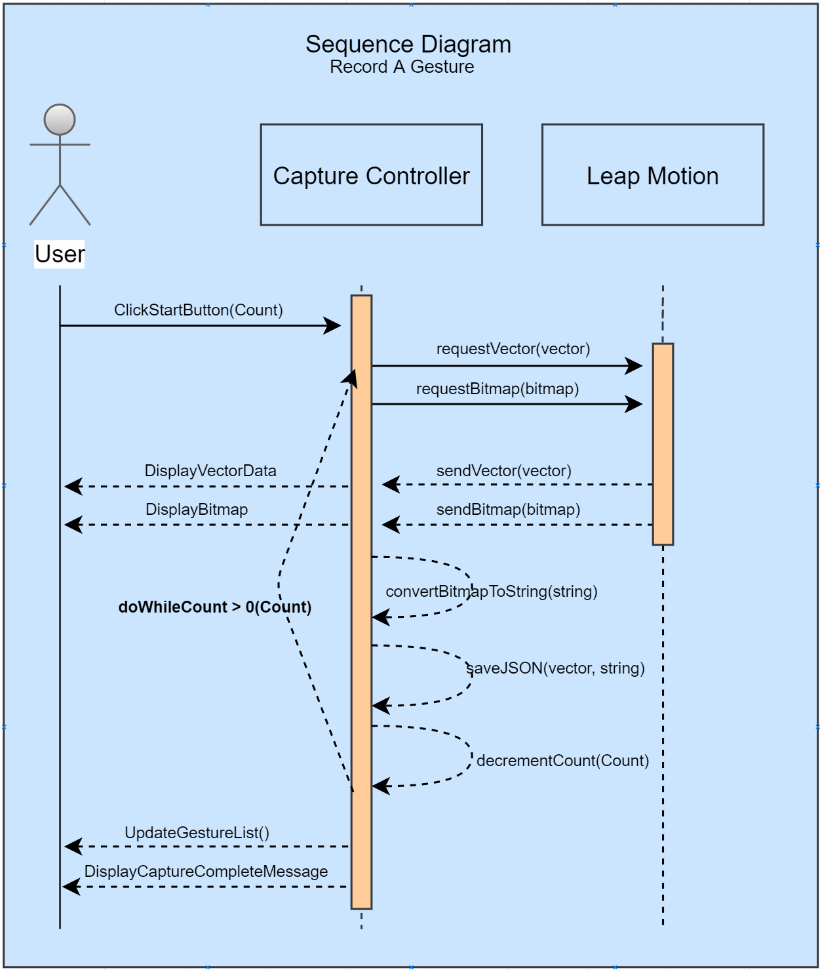
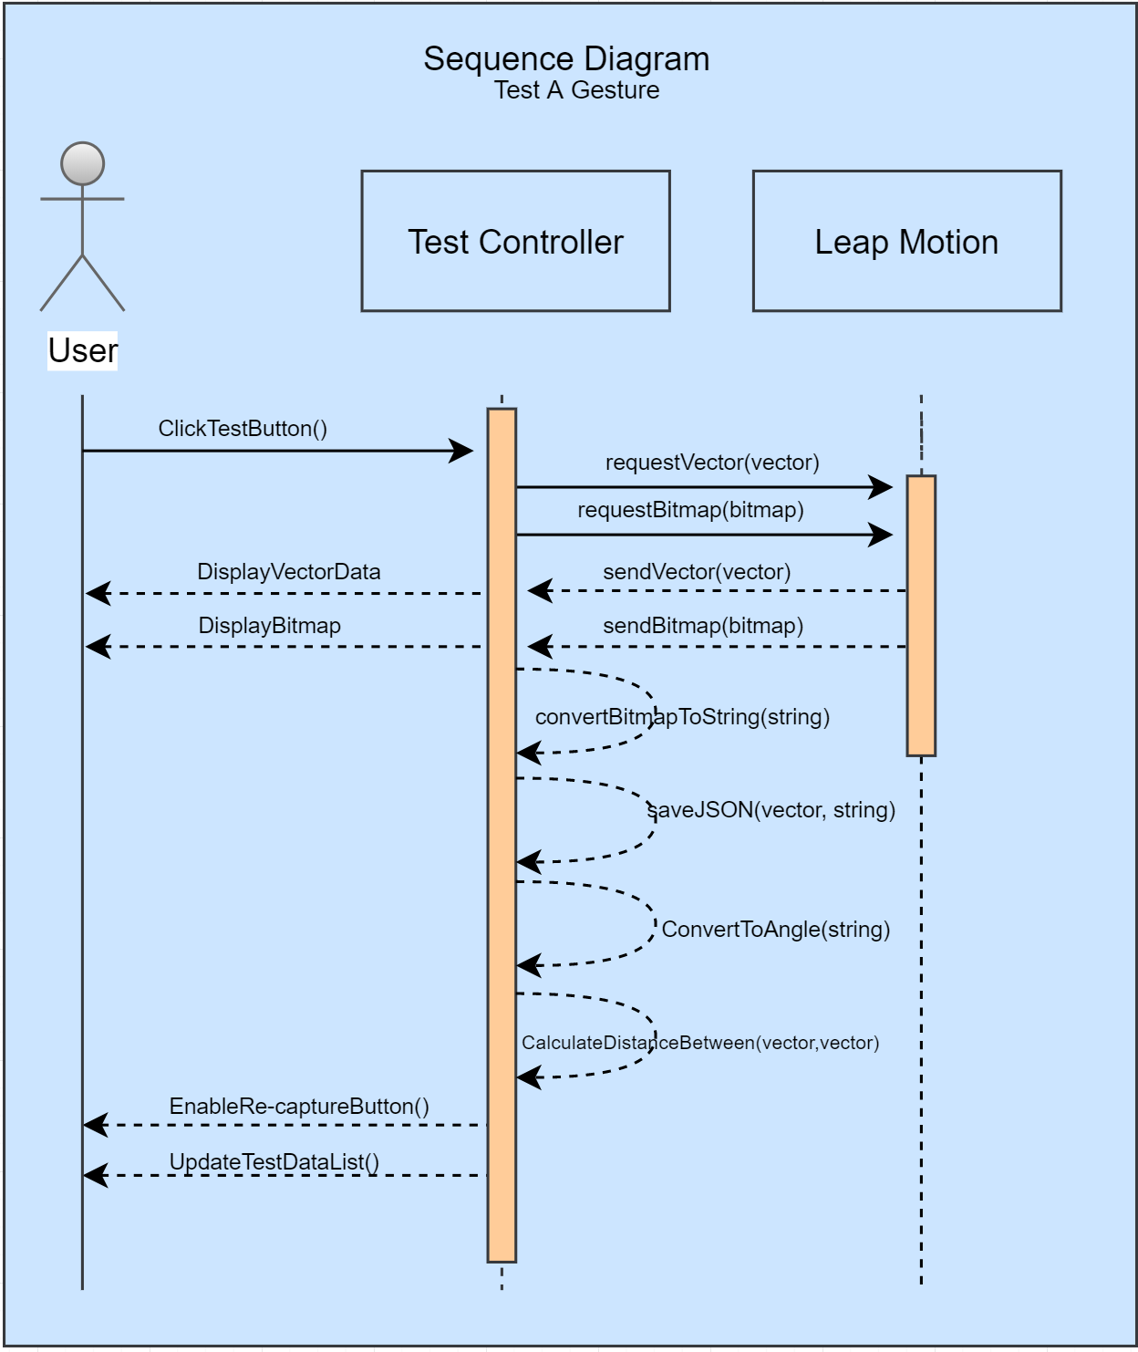
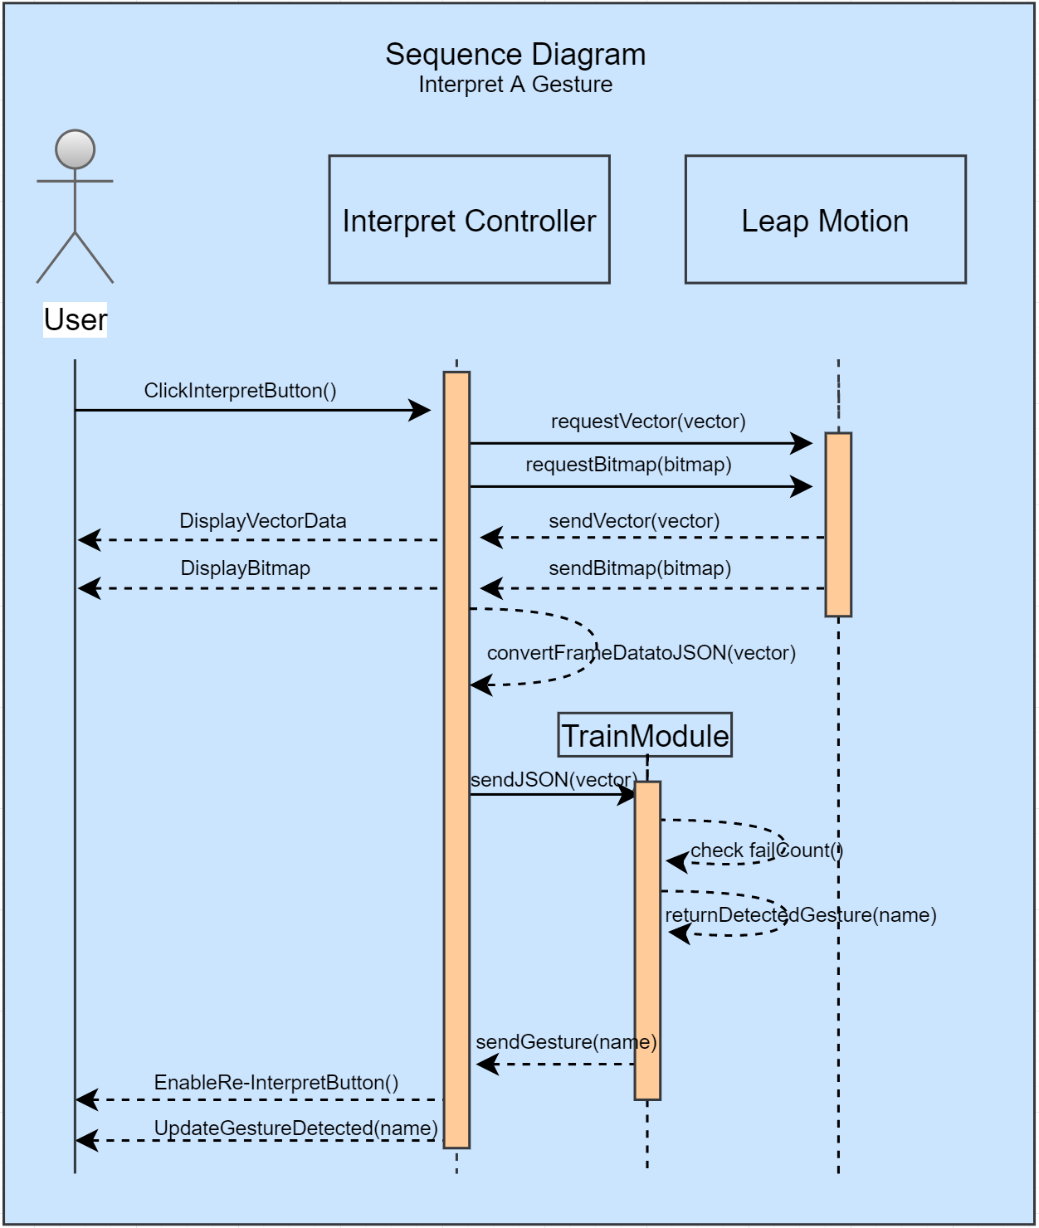
School of Computing & Information Sciences
VIP Senior Project, 2017, Fall
AR-VR-VE for Computer Science Education 1.0
Student: Filip Klepsa, Florida International University
Mentor: Francisco Ortega, Florida International University
Professor: Francisco Ortega & Masoud Sadjadi, Florida International University
Problem
The Leap Motion Controller (LMC) is a commercialized, palm-sized, infrared sensor designed to make capturing hand and finger movements in 3D space affordable. Applying machine learning methods, this project hopes to extend the usefulness to, or re-validate use of the LMC device for single-frame gesture recording and recognition. As the backbone of the American deaf culture, gesture recognition on American Sign Language (ASL) could potentially become an educational tool for children and adults.
Solution
Alas, the LEAP-Trainer was built! A single-frame gesture recording and recognition system utilizing the compact and affordable Leap Motion Controller. The English alphabet in American Sign Language is the set of gestures recorded, and recognition tested on. Applying K-nearest neighbor on recorded and trained frame vector data, experimental results obtained in this study show an average recognition rate of approximately 78% versus a test trained sample of 300 recorded frames per letter with accuracy increasing as the set of trained recorded frames grows.
Requirements
Screenshots
System Design
Implementation
Verification
Object Design
Summary
The LEAP-Trainer, a single-frame gesture recording and recognition software that utilizes the Leap Motion Controller optical, infrared sensor, designed by Leap Motion to perform detection and tracking of the human hand and its features. The LEAP-Trainer paired with the Leap Motion Controller, the right environment and application settings can accurately classify single-frame gestures in American Sign Language in real-time with an average accuracy of 78% per letter. Future work includes the possibility of extending the software to utilize more than one controller and to introduce a system that can support multi-framed gestures.
Acknowledgement
With support from Dr. Francisco Ortega and the AR-VR-VE for Computer Science Education team, the School of Computing and Information Sciences, Florida International University, and the user study testers: Ms. Sheila Alemany, Mr. Alberto Camacho, and Mr. Armando Carrasquillo.
Notes:
1

